Slide 1
FEATURE
FINDER
GOLDMAN SACHS
Bringing accessibility to cutting-edge insights

Slide 2
TABLE OF CONTENTS
01
02
03
OUR
SOLUTION
BUSINESS CASE
SOLUTION ARCHITECTURE
04
05
06
TECH STACK & FRAMEWORKS
PRODUCT DEMO
SUSTAINABILITY & SCALABILITY
Introducing our the problem and our solution
Potential markets and our value proposition
How the solution is structured
How we built our solution
A video demonstrating our solution’s
Scalability, Economic Empowerment and Social Sustainability

Slide 3

OUR
MISSION
Capitalize on the rush of companies to offer embedded financial services by reducing barriers to accessing industry-leading insights through Goldman Sachs’ Financial Cloud

Slide 4
OUR SOLUTION
PROBLEM
NEEDS
SOLUTION
Prospective clients (firms) deterred by complex onboarding process involving financial knowledge & difficulty indicating interests, which involves drafting an email to specify requirements
Simple onboarding process to introduce features of respective APIs, and seamless transition to liaising with GS consultants
An elegant form–based UI, to simultaneously introduce services WHILE collating client requirements

Slide 5
MARKET
EMBEDDED FINANCE
INDUSTRIES
2026
$138B
2021
$34B
Commerce
Social Media
Transport
Real Estate
GROWTH DRIVEN BY APIs FROM VENDORS¹
Statistics Courtesy of Juniper Research: https://www.juniperresearch.com/press/embedded-finance-market-value-exceed-138bn

Slide 6

BUSINESS PROPOSITION
As financial markets evolve, providing banking-as-a-service provides Goldman Sachs with a means of revenue diversification by tapping into growth opportunities via the strong capabilities of its API.
Our solution focuses of creating an optimal user experience to position GS Financial Cloud as the industry leader in both expertise and service, thus strengthening the competitive edge of GS’ API offerings to prospective clients.

Slide 7
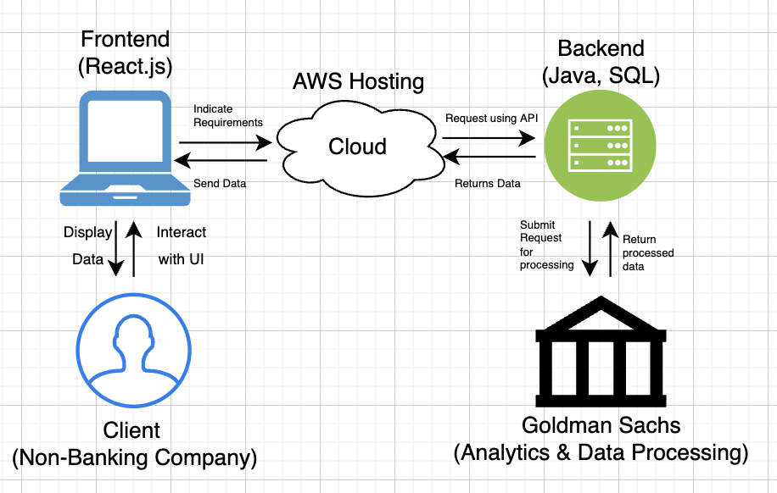
SOLUTION ARCHITECTURE

Slide 8
TECH STACK & FRAMEWORKS
FRONT-END
BACK-END
DATABASE
Javascript - React.js
Material UI Library
Java - Spring Boot
JDBC API
SQL

Slide 9
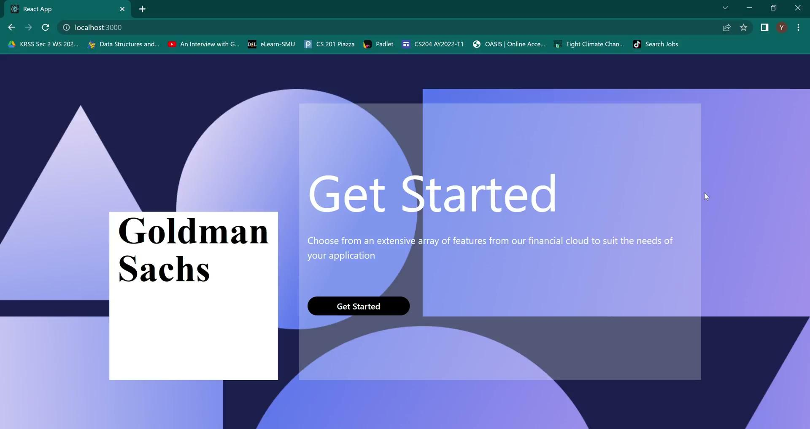
APP DEMONSTRATION VIDEO

Slide 10
SUSTAINABILITY & SCALABILITY
SCALABILITY | ECONOMIC EMPOWERMENT | SOCIAL SUSTAINABILITY
Besides maintenance of features and their descriptions within the database, our services can easily scale with the aid of cloud computing. | The APIs allow small businesses located in countries which may not have previously had access to GS’ services to provide embedded financial services without costs of building their own. | Reduces strain on consultants’ seeking to understand client requirements, since specific fields of client interest are identified, allowing smoother follow up process.

Slide 11






THANK YOU!

